Slide 1

Installing Java

Slide 2
Java Versioning
Java was first released in January ,1995.
Java started of as version 1.0. Later on 1.2, 1.3, 1.4 version were released.
With the coming of the 5th version , java versioning was changed. It now was versioned as Java 5.0 or Java 5.
The latest version that was release is Java 14, which was release on 17th of March, 2020.
In this course we would be focusing specifically on the Java version 11.

Slide 3
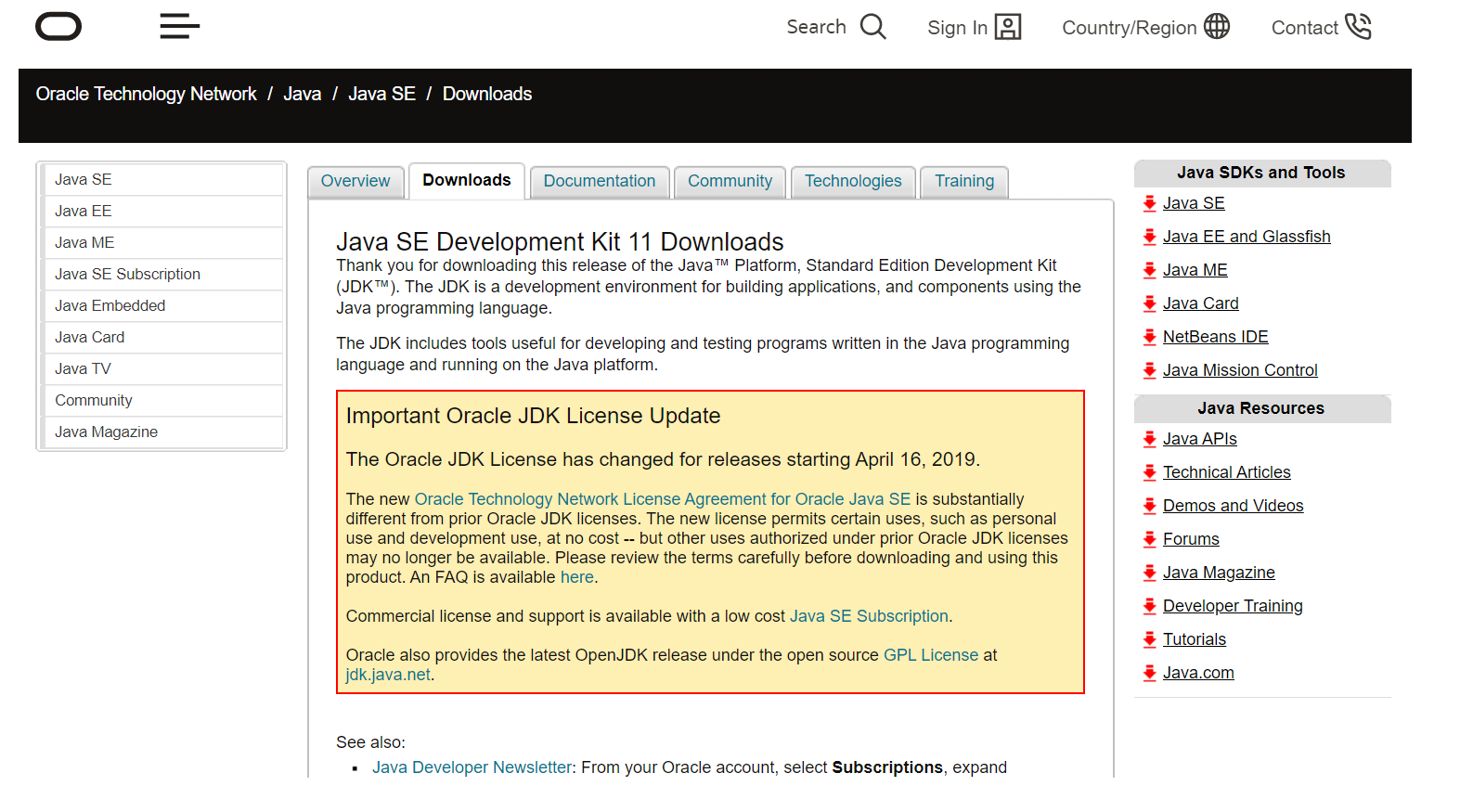
Downloading Java
Download Java SE Development Kit 11 from this link.

Slide 4
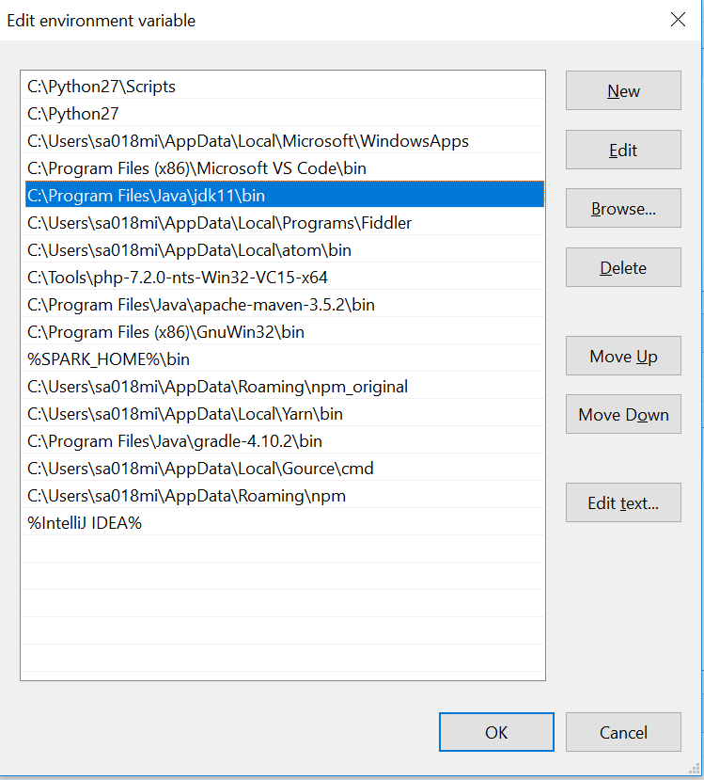
Installing Java
Click and run the downloaded installer. While installing the installer shall asks for an installation path.
After successful installation , copy the path till
<JDK Installation path>/bin.
Add above copied path to windows environment variables.
This makes java executables available from everywhere within the current OS installation.

Slide 5
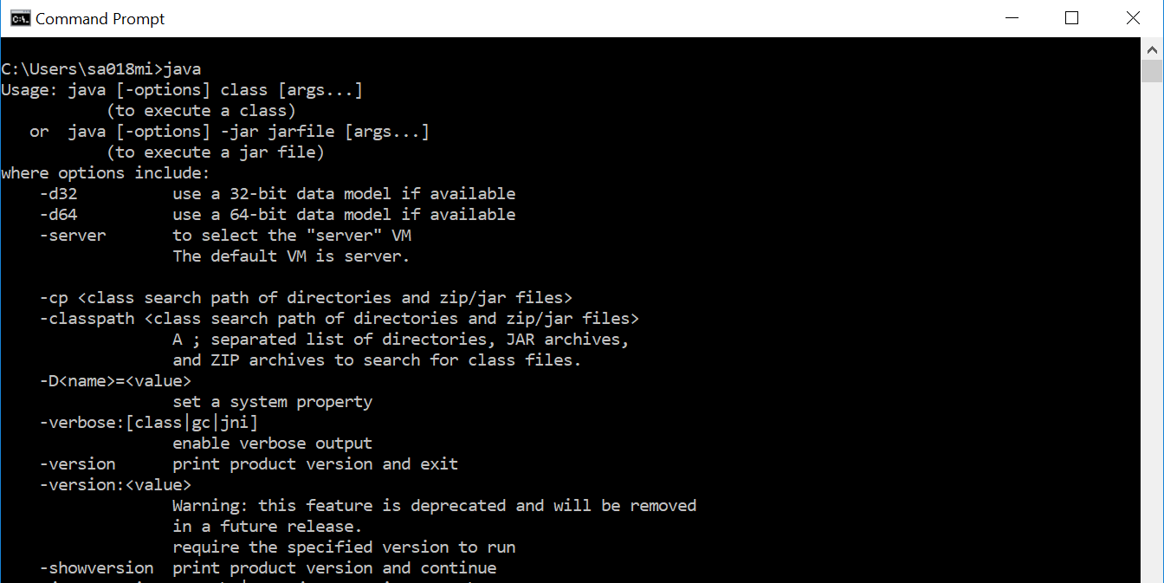
Is Java available on my system ??
Check to verify whether Java installation is installed and available from command line.

Slide 6
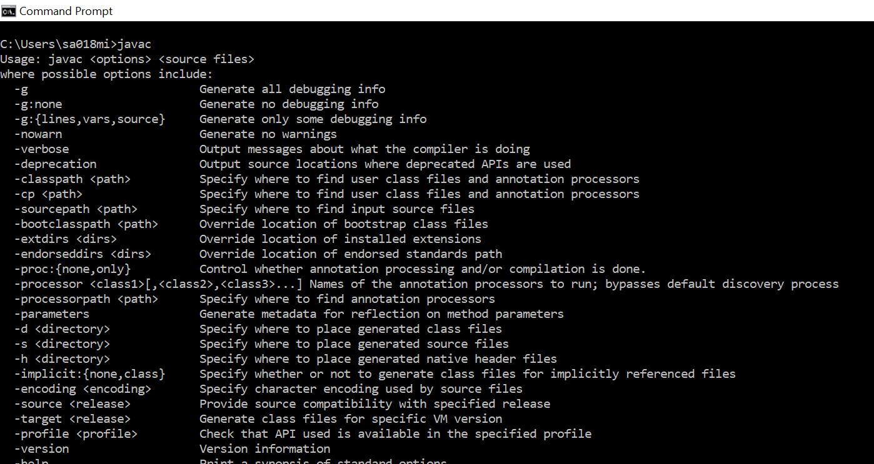
Is Java compiler available on my system ??
Check to verify whether Java compiler is available from command line.

